Slide 1

NIght VIsIon DEVICES AND EQUIPMENTS
Nurullah Mertel
18290219

Slide 2
content
Biological Night vision
Infrared Light
Technical Night vision
Thermal Imaging
Image Enhancement
Generations
Night Vision Equipment and Applications
References

Slide 3
INTRODUCTION
Night vision allows one to see in dark.
It is originally developed for Military use but also used for hunting, documentary.
With proper equipment, a person can see over 200 m on dark environment.

Slide 4
CLASSIFICATION
Night Vision can part into 2 categories for natural observation and human-made devices.
Biological Night Vision
Based on chemical and physical
reaction of eye.
Technical Night Vision
Thermal imaging
Image intensifier

Slide 5
Bıologıcal Nıght Vısıon
Molecules of rhodopsin of the eye goes into a change in shape as light is absorbed by them. For human, adoptation process last for 5-10 minutes but also can last up to 30 minutes. Rhodopsin in the human eye is insensitive to the longer red wavelengths of light, so many people use red light to preserve night vision as it will not deplete the eye's rhodopsin.
Some animals, such as cats, dogs, and deer, have a structure in the back of the eye that reflects light back towards the retina, increasing the amount of light it captures. In humans, only 10% of the light that enters the eye falls on photosensitive parts of the retina. Their ability to see in low light levels may be similar to what humans see when using first or perhaps second generation image intensifiers

Slide 6
ınfrared lıght
In order to understand night vision, it is important to understand something about light. The amount of energy in a light wave is related to its wavelength: Shorter wavelengths have higher energy. Of visible light, violet has the most energy, and red has the least. Just next to the visible light spectrum is the infrared spectrum.

Slide 7
Infrared lıght
Infrared light can be split into three categories:
Near-infrared (near-IR) - Closest to visible light, near-IR has wavelengths that range from 0.7 to 1.3 microns, or 700 billionths to 1,300 billionths of a meter.
Mid-infrared (mid-IR) - Mid-IR has wavelengths ranging from 1.3 to 3 microns. Both near-IR and mid-IR are used by a variety of electronic devices, including remote controls.
Thermal-infrared (thermal-IR) - Occupying the largest part of the infrared spectrum, thermal-IR has wavelengths ranging from 3 microns to over 30 microns.
The key difference between thermal-IR and the other two is that thermal-IR is emitted by an object instead of reflected off it. Infrared light is emitted by an object because of what is happening at the atomic level.

Slide 8
Technıcal Nıght Vısıon
A night vision device (NVD) is an optical instrument that allows images to be produced in levels of light approaching total darkness. They are most often used by military and law enforce agencies but are available to civilian users.
There are two main categories of night vision systems, active and passive. Active night vision systems use infrared light to illuminate dark surroundings, while passive systems rely on thermal radiation emitted by humans, animals and other objects at a temperature different from the ambient.
Night vision technologies can be broadly divided into two main categories: thermal imaging and image enhancement.

Slide 9
thermal ımagıng
Thermal imaging detects the temperature difference between background and foreground objects. Some organisms are able to sense athermal image by means of special organs that function as bolometers. This allows thermal infrared sensing in snakes, which functions by detecting thermal radiation.
Thermal imaging cameras are excellent tools for night vision. They detect thermal radiation and do not need a source of illumination. They produce an image in the darkest of nights and can see through light fog, rain, and smoke (to a certain extent). Thermal imaging cameras make small temperature differences visible. T

Slide 10
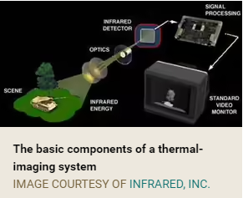
Thermal ımagıng
Here's how thermal maging works:
A special lens focuses the infrared light emitted by all of the objects in view.
The focused light is scanned by a phased array of infrared-detector elements. The detector elements create a very detailed temperature pattern called a thermogram.
The thermogram created by the detector elements is translated into electric impulses.
The impulses are sent to a signal-processing unit, a circuit board with a dedicated chip that translates the information from the elements into data for display.

Slide 11
Thermal ımagıng
5. The signal-processing unit sends the information to the display, where it appears as various colors depending on the intensity of the infrared emission. The combination of all the impulses from all of the elements creates the image.
Types of Thermal Imaging Devices
Most thermal-imaging devices scan at a rate of 30 times per second. They can sense temperatures ranging from -4 degrees Fahrenheit (-20 degrees Celsius) to 3,600 F (2,000 C), and can normally detect changes in temperature of about 0.4 F (0.2 C).
There are two common types of thermal-imaging devices:

Slide 12
THERMAL IMAGING
Un-cooled - This is the most common type of thermal-imaging device. The infrared-detector elements are contained in a unit that operates at room temperature. This type of system is completely quiet, activates immediately and has the battery built right in.
Cryogenically cooled - More expensive and more susceptible to damage from rugged use, these systems have the elements sealed inside a container that cools them to below 32 F (zero C). The advantage of such a system is the incredible resolution and sensitivity that result from cooling the elements. Cryogenically-cooled systems can "see" a difference as small as 0.2 F (0.1 C) from more than 1,000 ft (300 m) away, which is enough to tell if a person is holding a gun at that distance!
While thermal imaging is great for detecting people or working in near-absolute darkness, most night-vision equipment uses image-enhancement technology.

Slide 13
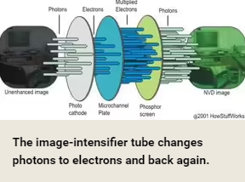
ımage enhancement
Image-enhancement technology is what most people think of when you talk about night vision. In fact, image-enhancement systems are normally called night-vision devices (NVDs). NVDs rely on a special tube, called an image-intensifier tube, to collect and amplify infrared and visible light.

Slide 14
ımage enhancement
Here's how image enhancement works:
A conventional lens, called the objective lens, captures ambient light and some near-infrared light.
The gathered light is sent to the image-intensifier tube. In most NVDs, the power supply for the image-intensifier tube receives power from two N-Cell or two "AA" batteries. The tube outputs a high voltage, about 5,000 volts, to the image-tube components.
The image-intensifier tube has a photocathode, which is used to convert the photons of light energy into electrons.

Slide 15
ımage enhancement
As the electrons pass through the tube, similar electrons are released from atoms in the tube, multiplying the original number of electrons by a factor of thousands through the use of a microchannel plate (MCP) in the tube.
At the end of the image-intensifier tube, the electrons hit a screen coated with phosphors. The energy of the electrons causes the phosphors to reach an excited state and release photons. These phosphors create the green image on the screen that has come to characterize night vision.
The green phosphor image is viewed through another lens, called the ocular lens, which allows you to magnify and focus the image. The NVD may be connected to an electronic display, such as a monitor, or the image may be viewed directly through the ocular lens.

Slide 16
generatıons
NVDs have been around for more than 40 years. They are categorized by generation. Each substantial change in NVD technology establishes a new generation.
Generation 0 - The original night-vision system created by the United States Army and used in World War II and the Korean War, these NVDs use active infrared. These systems use an anode in conjunction with the cathode to accelerate the electrons. The problem with that approach is that the acceleration of the electrons distorts the image and greatly decreases the life of the tube.
Generation 1- The next generation of NVDs moved away from active infrared, using passive infrared instead. They did not require a source of projected infrared light. This also means that they do not work very well on cloudy or moonless nights. Generation-1 NVDs use the same image-intensifier tube technology as Generation 0, with both cathode and anode, so image distortion and short tube life are still a problem.

Slide 17
generatıons
Generation 2 - Major improvements in image-intensifier tubes resulted in Generation-2 NVDs. They offer improved resolution and performance over Generation-1 devices, and are considerably more reliable. The biggest gain in Generation 2 is the ability to see in extremely low light conditions, such as a moonless night.
Generation 3 - Generation 3 is currently used by the U.S. military. While there are no substantial changes in the underlying technology from Generation 2, these NVDs have even better resolution and sensitivity. This is because the photo cathode is made using gallium arsenide, which is very efficient at converting photons to electrons.
Generation 4 - What is generally known as Generation 4 or "filmless and gated" technology shows significant overall improvement in both low- and high-level light environments. The removal of the ion barrier from the MCP that was added in Generation 3 technology reduces the background noise and thereby enhances the signal to noise ratio.

Slide 18
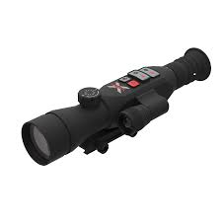
Night Vision Equipment and Applications
Night-vision equipment can be split into three broad categories:
Scopes - Normally handheld or mounted on a weapon, scopes are monocular (one eye-pieces). Since scopes are handheld, not worn like goggles, they are good for when you want to get a better look at a specific object and then return to normal viewing conditions.
https://xvisionoptics.com/product/krad-night-vision-scope-xans550/

Slide 19
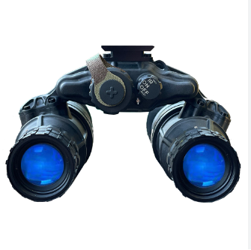
Night Vision Equipment and Applications
Goggles - While goggles can be handheld, they are most often worn on the head. Goggles are binocular (two eye-pieces) and may have a single lens or stereo lens, depending on the model. Goggles are excellent for constant viewing, such as moving around in a dark building.
https://usnightvision.com/dtnvs-gen-iii-white-phosphor-dual-tube-night-vision-goggle/

Slide 20
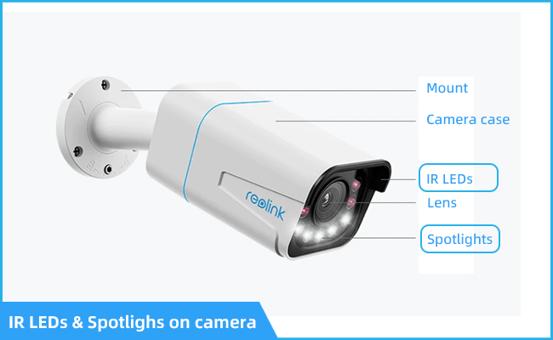
Night Vision Equipment and Applications
Cameras - Cameras with night-vision technology can send the image to a monitor for display or to a VCR for recording. When night-vision capability is desired in a permanent location cameras are used. Many of the newer camera recorders have night vision built right in.
https://reolink.com/blog/night-vision-security-camera/

Slide 21
applıcatıons
Common applications for night vision include:
Military
Law enforcement
Hunting
Wildlife observation
Surveillance
Security
Navigation
Hidden-object detection
Entertainment

Slide 22
applıcatıons
The original purpose of night vision was to locate enemy targets at night. It is still used extensively by the military for that purpose, as well as for navigation, surveillance and targeting.
Night vision systems can also be installed in vehicles. An automotive night vision system is used to improve a vehicle driver's perception and seeing distance in darkness or poor weather. Such systems typically use infrared cameras, sometimes combined with active illumination techniques, to collect information that is then displayed to the driver. Such systems are currently offered as optional equipment on certain premium vehicles.

Slide 23
conclusıon
Night vision devices use image intensifiers tubes to amplify ambient light to produce brighter images of the surroundings. Responders use these devices during nighttime surveillance, search and rescue, and cover operations.

Slide 24
THANK YOU!

Slide 25
References
https://electronics.howstuffworks.com
https://www.bushnell.com/through-the-lens/
https://gloomgroup.com/blogs/night-vision-info/
https://www.seminarstopics.com/seminar/5647/night-vision-technology

